Slide 1
Website Accessibility Assessment

Slide 2
Landing Page
As previously discussed, the pictures need updating. But what needs to be noted is that the photos need to be decreased in size. A good website for decreasing the size of photos is https://squoosh.app/
Photos of the size that is currently on the landing page slow down the website considerably, especially since if a mobile device is on 3G, it takes a good 20 seconds to load. Which can dramatically increase the bounce rate.
Another website that should be used to check the contrast of the writing colours, is Coolors. https://coolors.co/contrast-checker/112a46-acc8e5
It’s especially important for people with Dyslexia, Irlen’s syndrome and colour blindness to be able to read writing with enough contrast. With this website you can also check what our colours look like to people with different types of colour blindness, I have included these examples in the next slides. (Skip to slide 7)
As shown on Coloors, our current palette (grey on white) doesn’t get a very positive score, in fact, it is below the average acceptance rate. Even some of the white writing against our gradient over our photos doesn’t get a very good score.

Slide 3
Original
Protanopia
Deuteranopia

Slide 4
Original
Tritanopia
Achromatopsia

Slide 5
Original
Protanomaly
Deuteranomaly

Slide 6
Original
Tritanomaly
Achromatomaly

Slide 7
Analytics
As stated, accessibility can affect the bounce rate and the general performance of a website. I have used a chrome extension called Lighthouse to assess the performance of the website, which I have provided in the coming slides.
The other web evaluation tool used is Wave, the assessments can be found on slide 10. This tool allows you to see where there are contrast problems, structure elements and errors.
One extension that I have found recently that tests out accessibility for people with visual disabilities is Skilltide. They simulate Dyslexia, Tunnel vision, colour blindness and more. Some examples are shown on page 12.
To download the Lighthouse:
https://chrome.google.com/webstore/detail/lighthouse/blipmdconlkpinefehnmjammfjpmpbjk?hl=en
To download the Wave:
https://chrome.google.com/webstore/detail/wave-evaluation-tool/jbbplnpkjmmeebjpijfedlgcdilocofh
To download the Skilltide:
https://chrome.google.com/webstore/detail/silktide-website-accessib/okcpiimdfkpkjcbihbmhppldhiebhhaf/related

Slide 9
The report goes into detail about each point; Performance, Accessibility, Best Practices, SEO and PWA. Once we have finished editing the website, like editing the photos and fixing up the navigation bar, it will be beneficial to go back to Lighthouse to see where we could improve further on the technical side.
(There is more information when you scroll down on the report.)

Slide 10
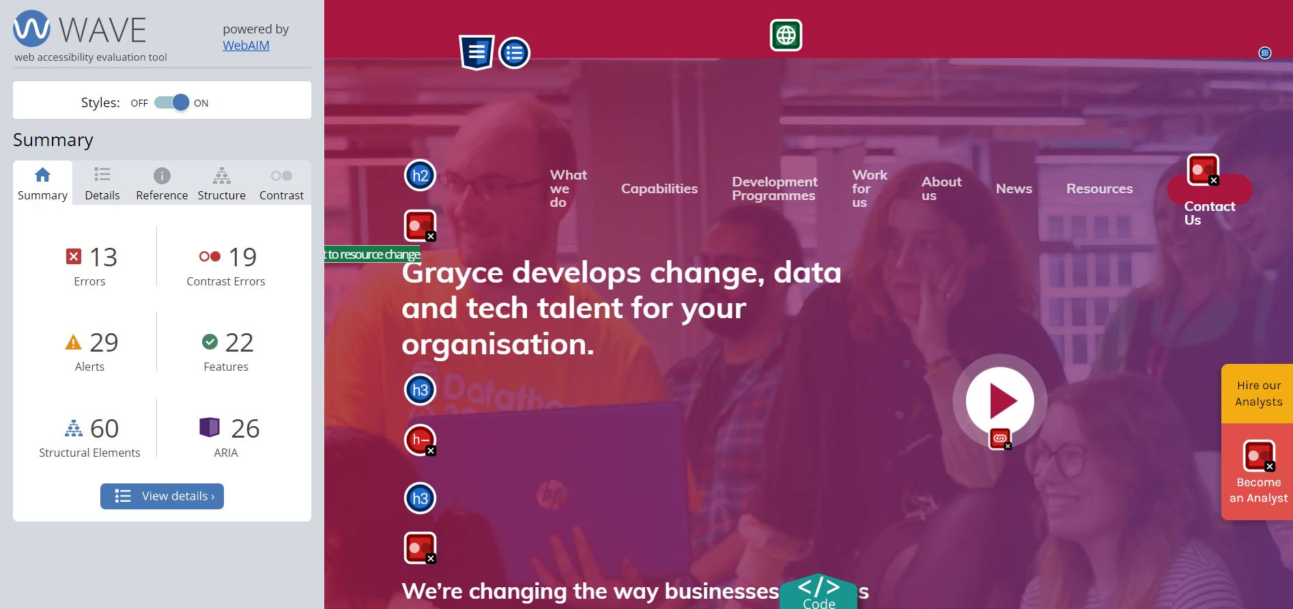

Slide 11
This is just a review of the landing page; each page has its own set of errors and alerts.

Slide 12
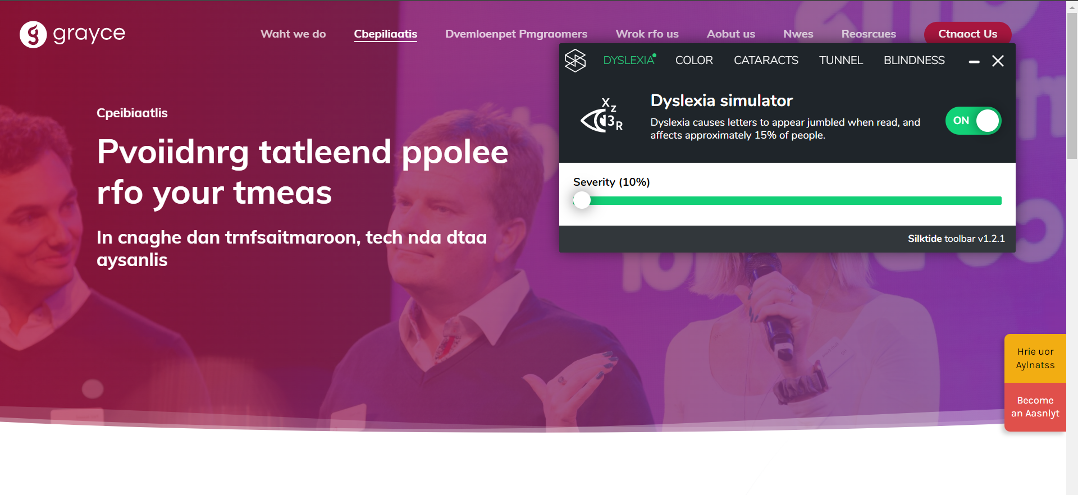

Slide 13
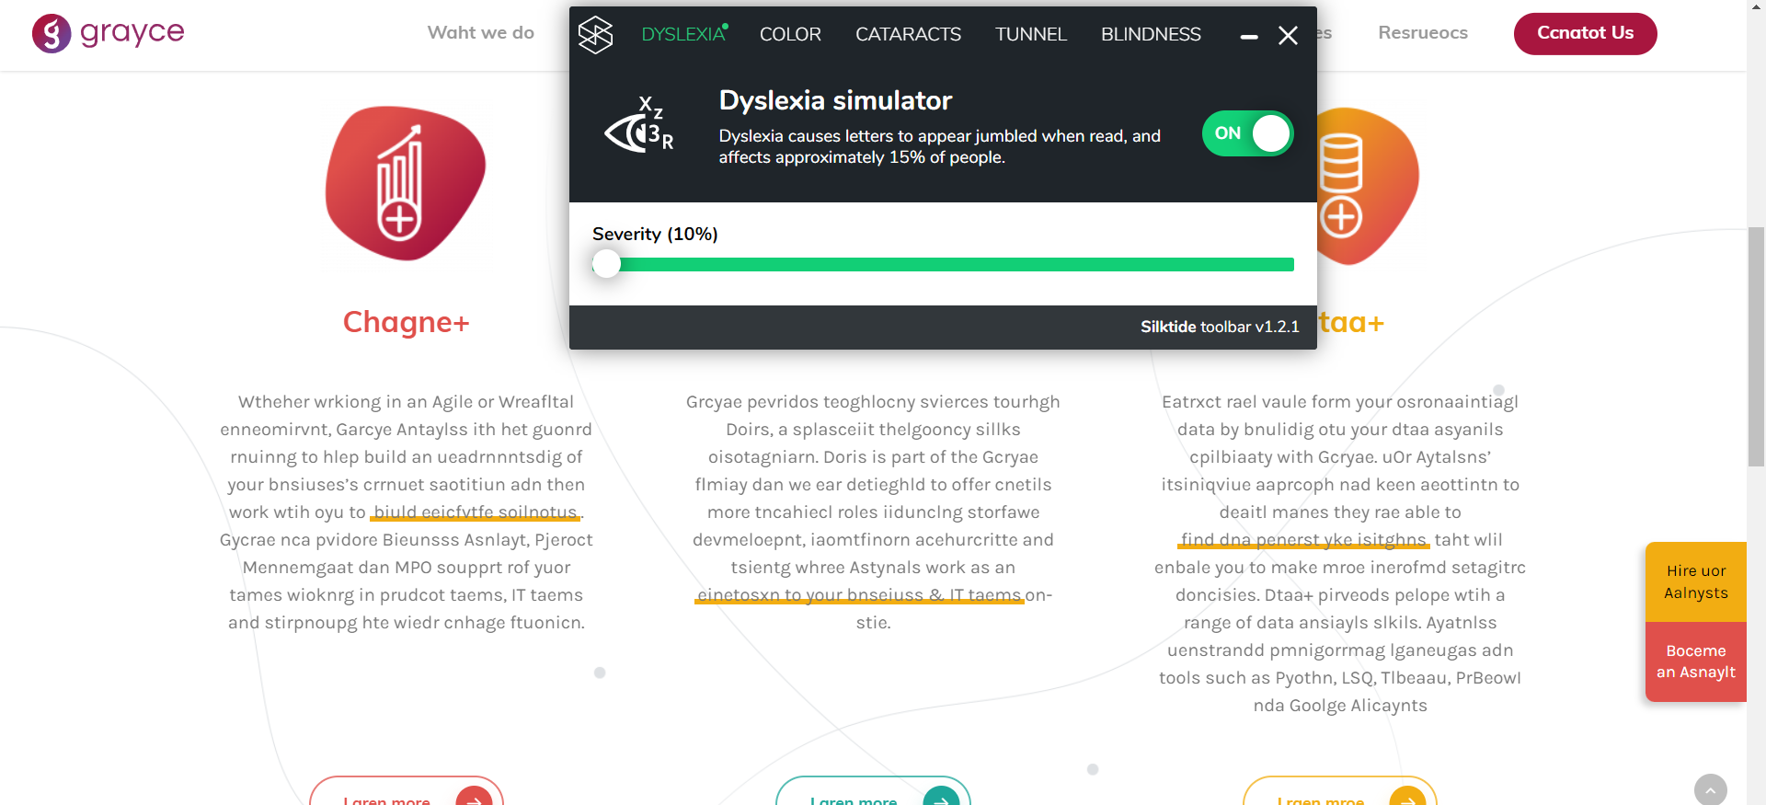

Slide 14
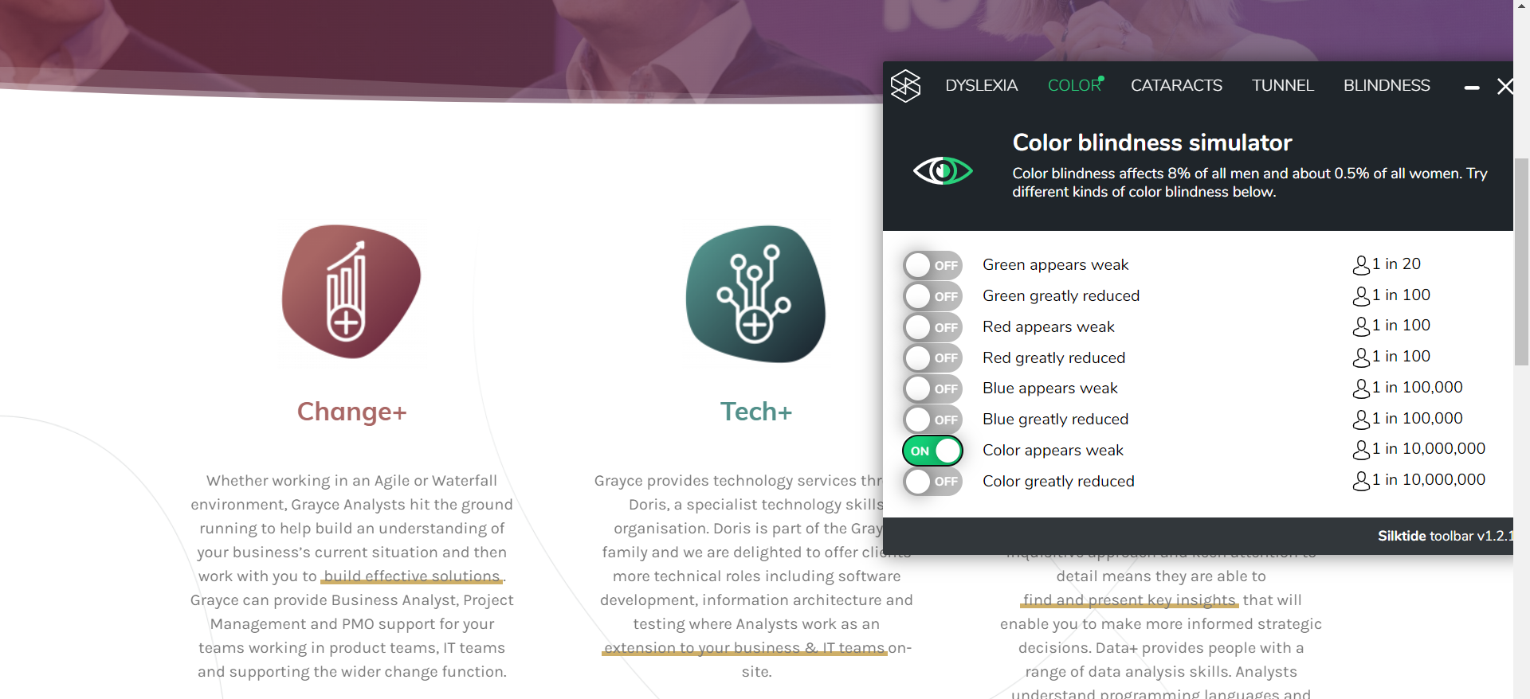

Slide 15
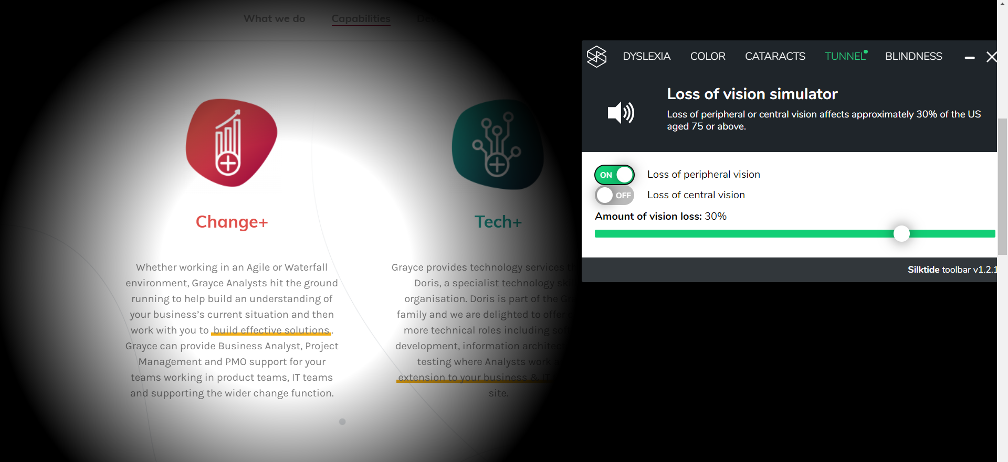

Slide 16
